Slide 1


Song development in zebra finch: modelling the growth and splitting of sequential chains of neural activity
Hannah Payne
5/23/16
Okubo, Mackevicius, Payne, Lynch, and Fee, Nature 2015

Slide 2
1. Question
How are complex motor sequences formed from simple underlying components?
2. Approach
Network model of sequence formation and differentiation using STDP and heterosynaptic competition plasticity rules

Slide 3
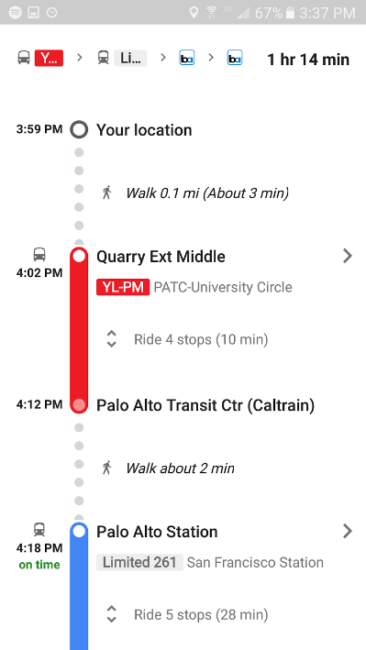
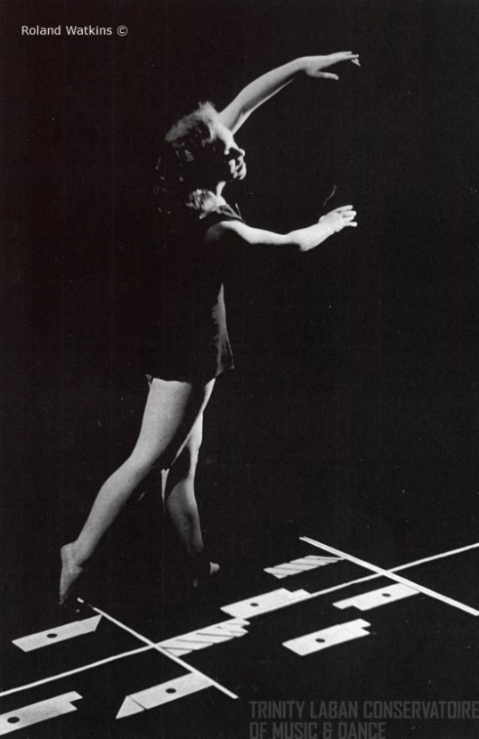
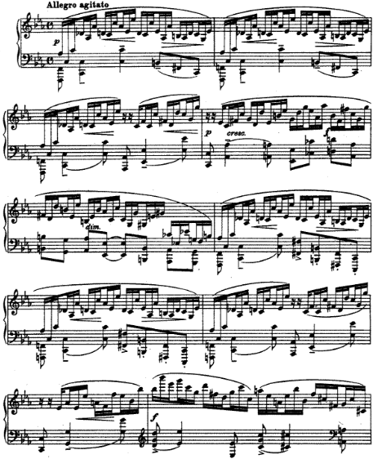
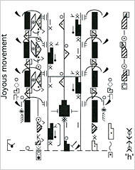

Becoming an expert at producing complicated motor sequences requires breaking them into simple parts
Notes:
Music is separated into beats. Dance is separated into steps. Behavior is separated into chunks (maybe pick different picture for this one).

Slide 4
How can the brain learn complex motor programs from simple building blocks?
Start with a “prototype” building block (short sequence of neural activity)
Replicate the prototype & differentiate the copies
Build complex sequences (long, flexible sequence of neural activity)

Slide 5
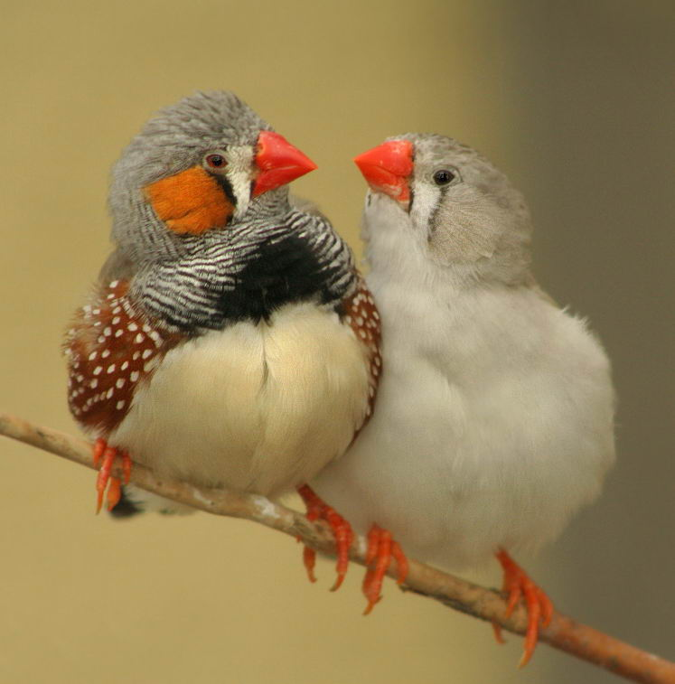

Birdsong is organized into syllables
a
b
c
a
b
c
a
b
c
Tutor song
Courtesy of Emily Mackevicius
Notes:
See also Seki Y, Suzuki K, Takahasi M, Okanoya K 2008

Slide 6
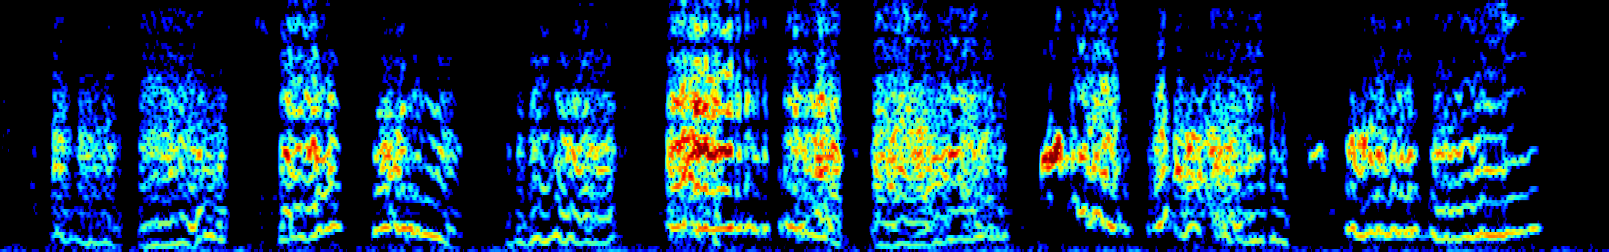
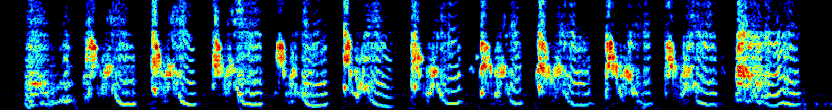
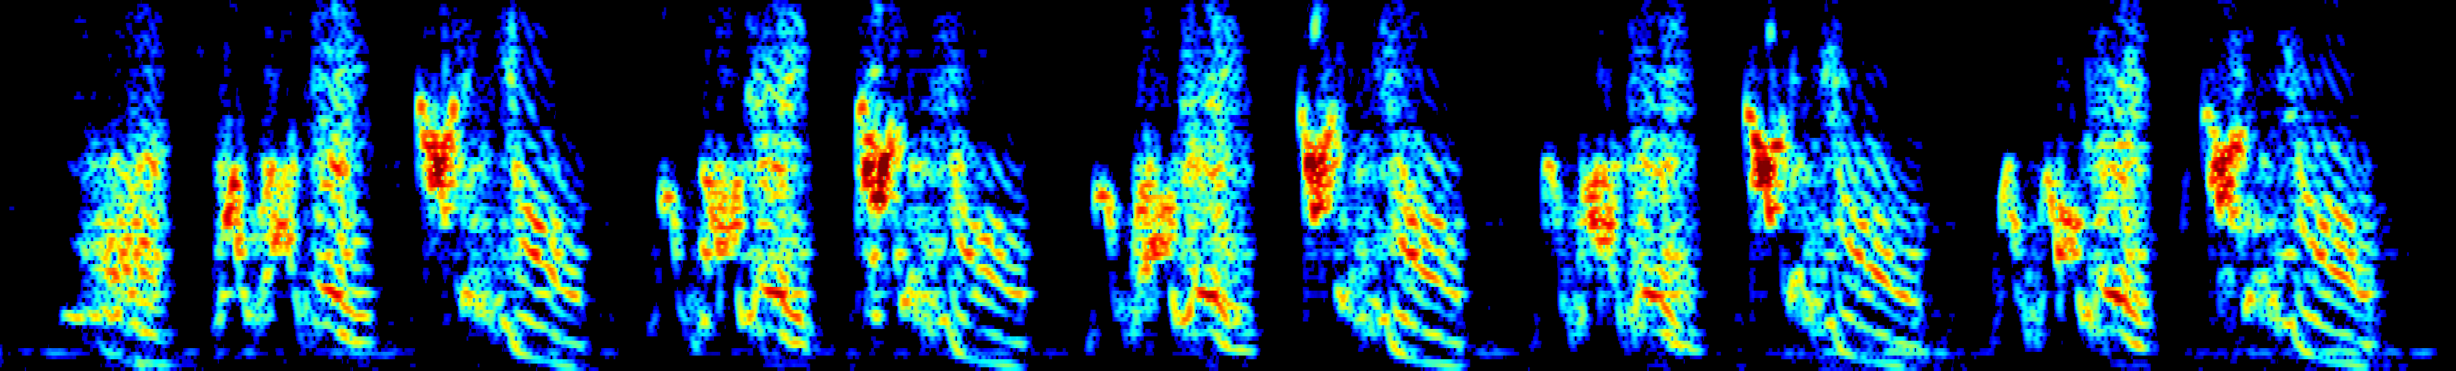
Songbirds learn to sing through a series of stages
a
b
c
a
b
c
a
b
c
Subsong
40
days post hatch
Protosyllables
60
Differentiated syllables
80
100
Crystalized adult
a
b
c
a
b
c
a
b
c
Tutor song
Note
Syllable
Example songs from Tatsuo Okubo and Ofer Tchernichovski, Courtesy of Emily Mackevicius
Motif
200 ms

Slide 7
How the songbird brain produces song
HVC
RA
output
Courtesy of Emily Mackevicius

Slide 8
How the songbird brain produces song
HVC
RA
output
(Hahnloser, Kozhevnikov and Fee, 2002
Lynch, Okubo et al., under review)

Slide 9
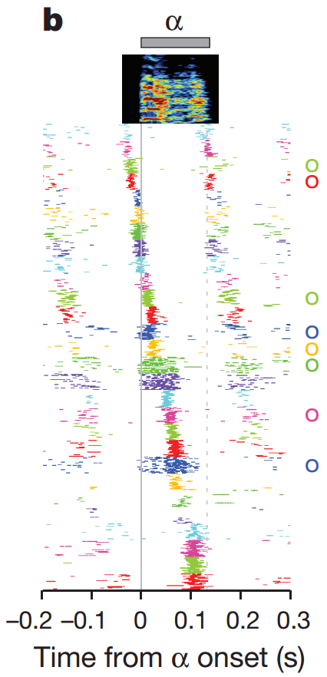
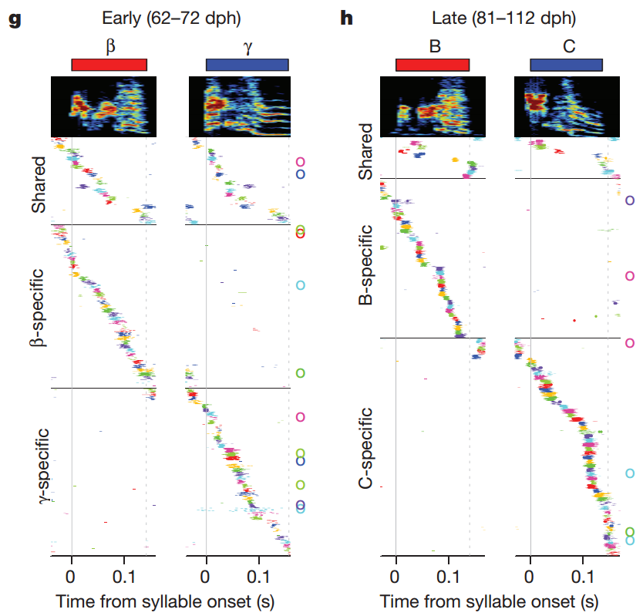
The protosequence starts to split as birds develop new syllable types
Okubo, Mackevicius, Payne, Lynch and Fee, Nature 2015

Slide 10
The protosequence keeps splitting as syllables differentiate
Okubo, Mackevicius, Payne, Lynch and Fee, Nature 2015

Slide 11
Protosyllable single “wide chain” sequence of neural activity
Differentiated syllables multiple “narrow chain” sequences of neural activity

Slide 12
Question
How are complex motor sequences formed from simple underlying components?
Hypothesis
Differentiation of protosyllables through splitting of the underlying neural sequence
Approach
Network model of sequence formation and differentiation

Slide 13
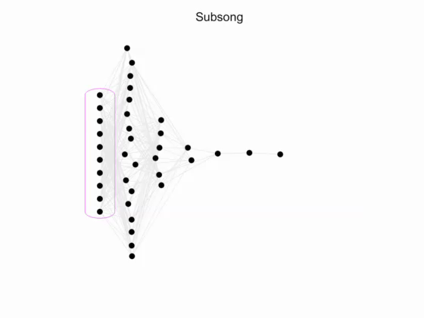
Movie of model HVC development: sequence growing and splitting
Okubo, Mackevicius, Payne, Lynch and Fee, Nature 2015

Slide 14
Model of the growth and splitting of sequential chains of activity in HVC
External input
Start with a randomly connected recurrent network
Include simple learning rules:
STDP and synaptic competition (Jun & Jin 2007, Fiete et al. 2010)
Drive it with seed inputs
Achieve:
Growth of a protosyllable chain
Splitting into multiple daughter syllables
HVC
Seed neurons
Okubo, Mackevicius, Payne, Lynch and Fee, Nature 2015

Slide 15
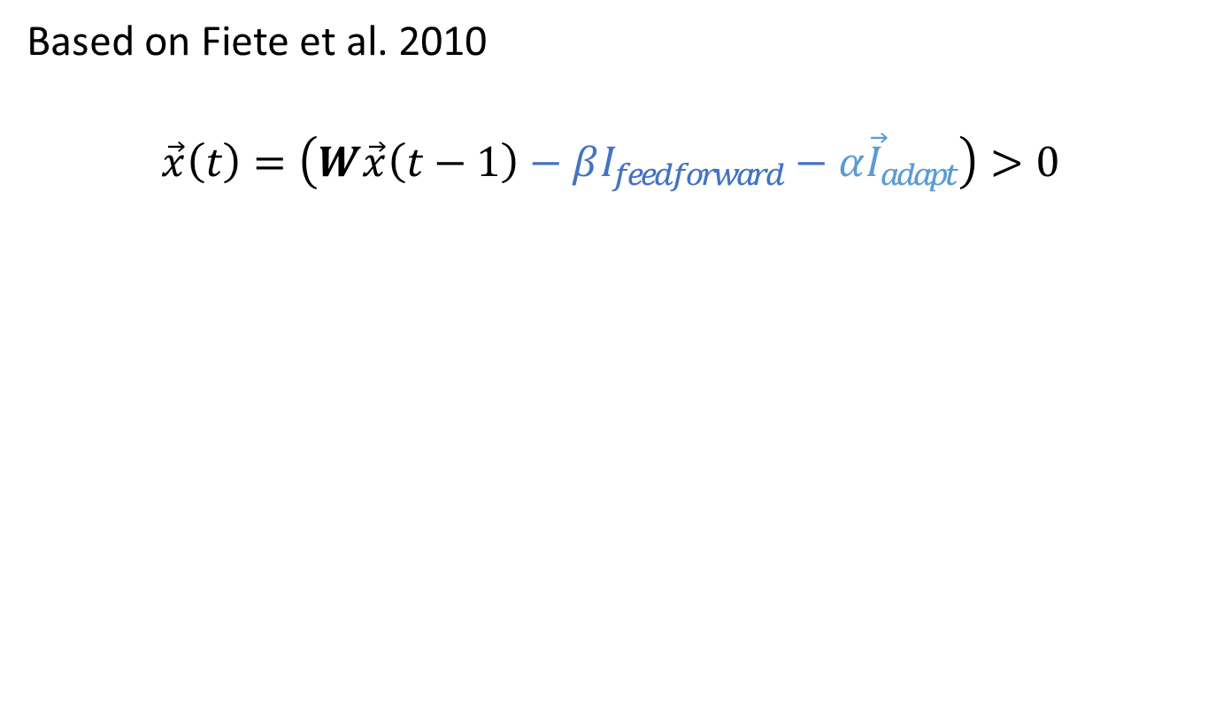
Binary neuron model
Based on Fiete et al. 2010
$$\vec{x}\left(t\right)=\left(W\vec{x}\left(t−1\right)−βI_{feedforward}−α{\vec{I}}_{adapt}\right)>0$$
Feed forward-inhibition
Adaptation term
W_{ij}
j
i

Slide 16
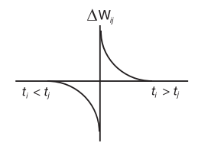
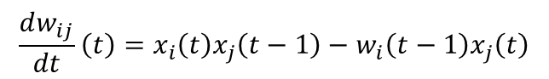
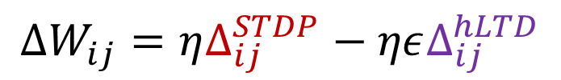
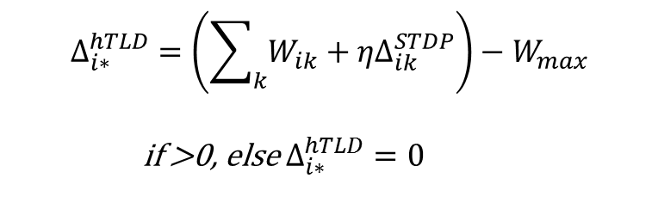
Plasticity rules
$$ΔW_{ij}=ηΔ_{ij}^{STDP}−ηεΔ_{ij}^{hLTD}$$
STDP (simplified)
Heterosynaptic LTD: summed-weight limit rule
W_{ij}
j
i
w_{max} = W_{max} /m
For incoming synapses to neuron i:
$$\frac{dw_{ij}}{dt}\left(t\right)=x_{i}\left(t\right)x_{j}\left(t−1\right)−w_{i}\left(t−1\right)x_{j}\left(t\right)$$
$$Δ_{i∗}^{hTLD}=\left(\sum_{k}{W_{ik}}+{ηΔ}_{ik}^{STDP}\right)−W_{max}$$
if >0, else $Δ_{i∗}^{hTLD}=0$
Fiete et al. 2010

Slide 17
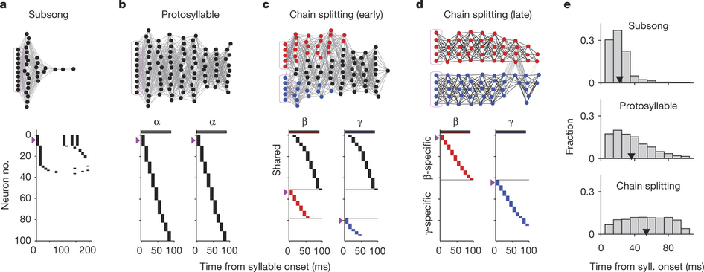
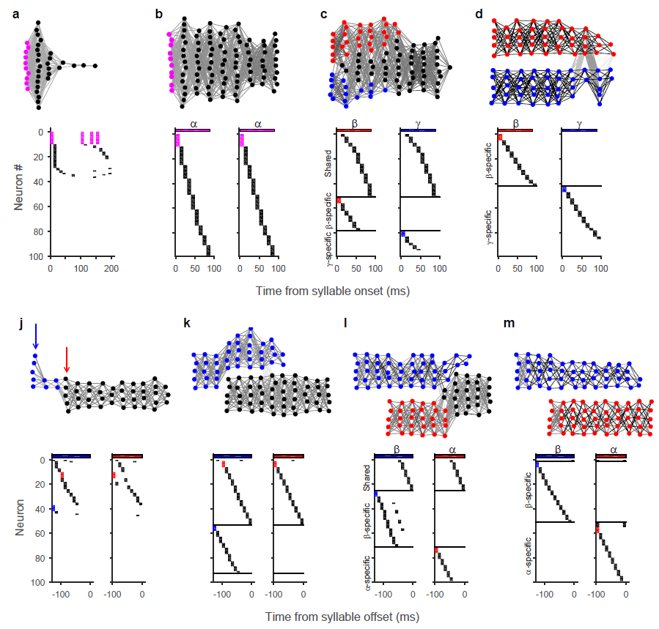
Formation of a synaptically-connected protosyllable chain
Before learning, transient inputs trigger a brief ripple of activity
After learning, activity propagates along a robust protosyllable chain
Weight matrix is a block-permutation matrix
Okubo, Mackevicius, Payne, Lynch and Fee, Nature 2015

Slide 18
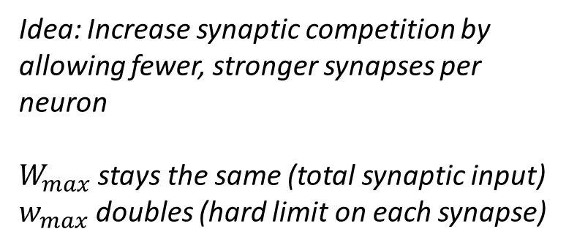
Splitting of the protosyllable chain into two daughter sequences
Idea: Increase synaptic competition by allowing fewer, stronger synapses per neuron
$W_{max}$ stays the same (total synaptic input)
$w_{max}$ doubles (hard limit on each synapse)
j
i
w_{max}
W_{max}
Also increase lateral inhibition to encourage splitting, and divide seed inputs into two groups
Okubo, Mackevicius, Payne, Lynch and Fee, Nature 2015

Slide 19
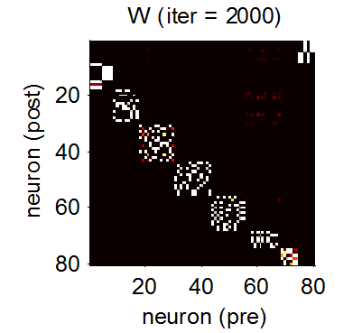
Splitting of the protosyllable chain into two daughter sequences
Okubo, Mackevicius, Payne, Lynch and Fee, Nature 2015

Slide 20
Question
How are complex motor sequences formed from simple underlying components?
Hypothesis
Differentiation of a prototype syllable through splitting of a neural sequence
Approach
Network model of sequence formation and differentiation using STDP and heterosynaptic competition plasticity rules
Further questions
Dependence on specific formulation of plasticity rules, systematic exploration of parameter sensitivity
We used increasing lateral inhibition + increased heterosynaptic competition to break up initial wide chain, other mechanisms?
Extension to non-binary neurons

